Slide 1
The Role of Oil Prices
in Russia’s Economy
Group members: Michael Corcoran, Susan Hsieh,
Eric Nechayev, Chixiang Qiu, Yujia Zhou

Slide 2
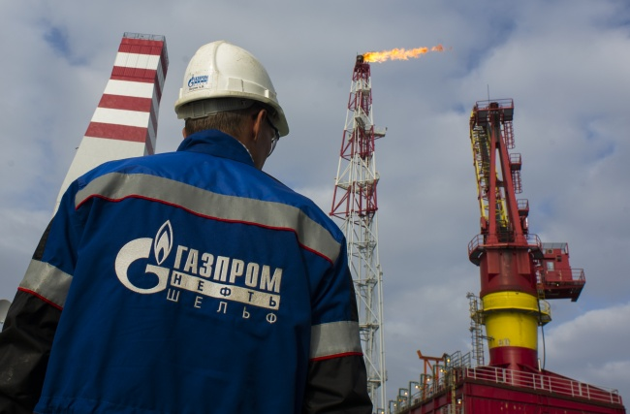
Introduction
Economy is highly dependent
In 2013, oil and gas was 68% of Russian exports
Oil and gas is nearly half of the Russian government’s budget
Oil price directly impacts the Ruble price:
Cheap oil causes depreciation
Correlation strengthened as oil production increased
Crucial factor in geopolitics
May impact military spending

Slide 3
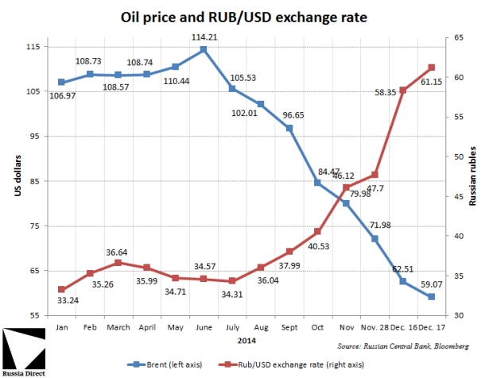
Economic Impact
of the Oil Price
As cheap oil weakens the Russian economy, this causes the ruble to depreciate, leading to inflation.
Causes high volatility in foreign exchange markets.
Currency weakness accelerated inflation to a 13-year high of 16.9 percent in March 2015.
Annual consumer-price growth eased to 12.9 percent in December 2015.
Notes:
http://www.russia-direct.org/rd-explainer-oil-prices-and-russia
Russian Central Bank, bloomberg graph

Slide 4
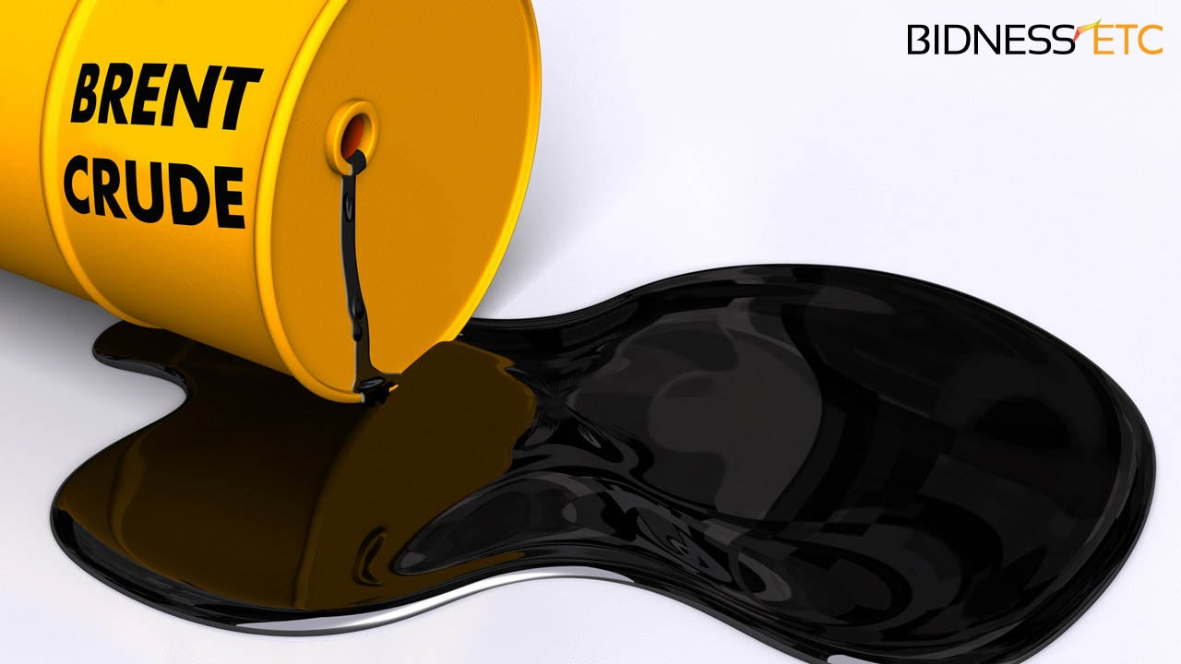
Data set
2003 Q1 - 2016 Q3
Gross Domestic Product (GDP)
Gross Operating Surplus (GOS)
Real Effective Exchange Rates (REE)
Global Price of Brent Crude (GBC)

Slide 5
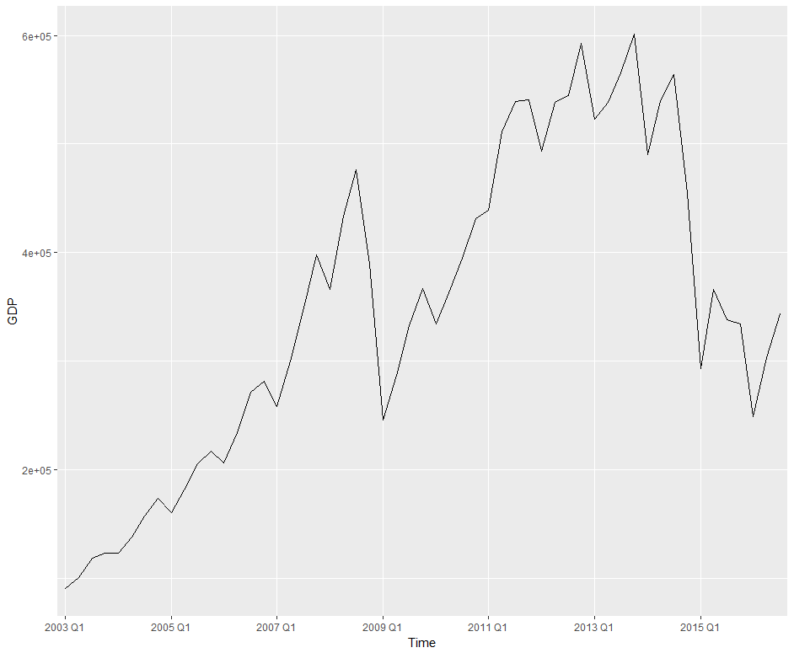
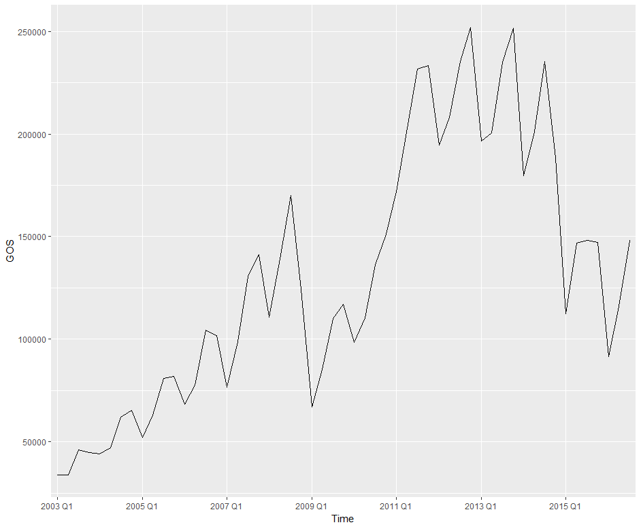
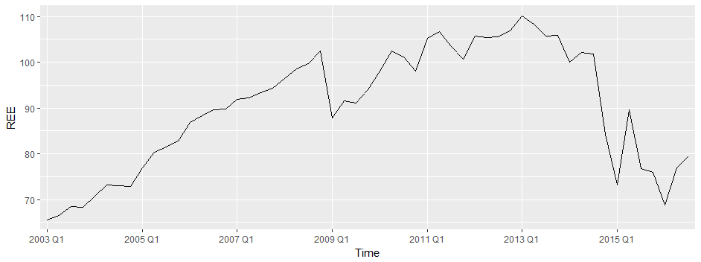
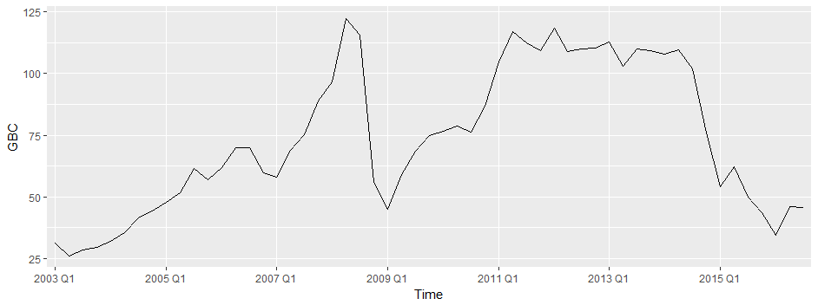
G
D
P
G
O
S
R
E
E
G
B
C

Slide 6
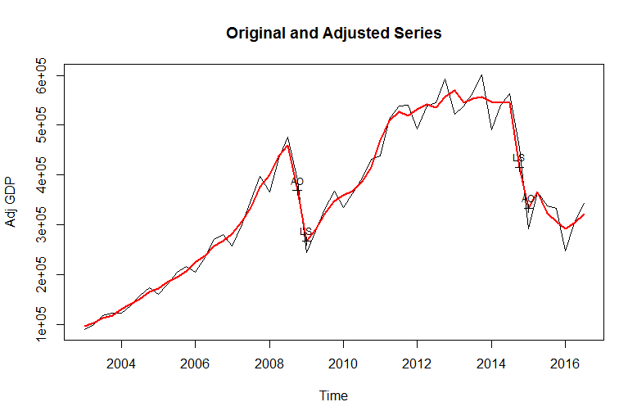
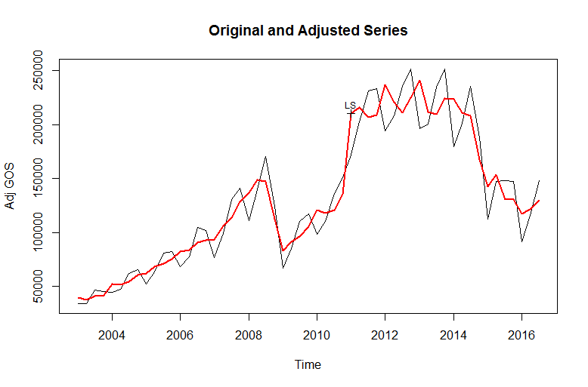
Seasonal adjustment
by using X-13ARIMA-Seats
Notes:
X-13ARIMA-Seats cut off one year

Slide 7
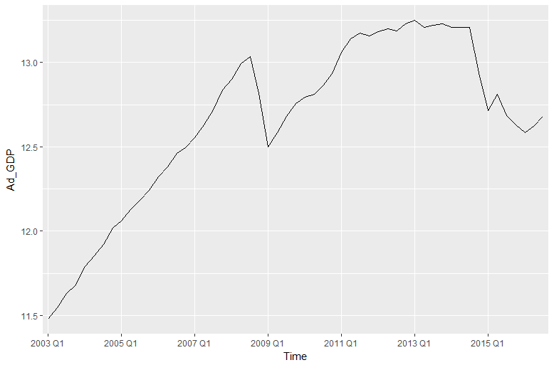
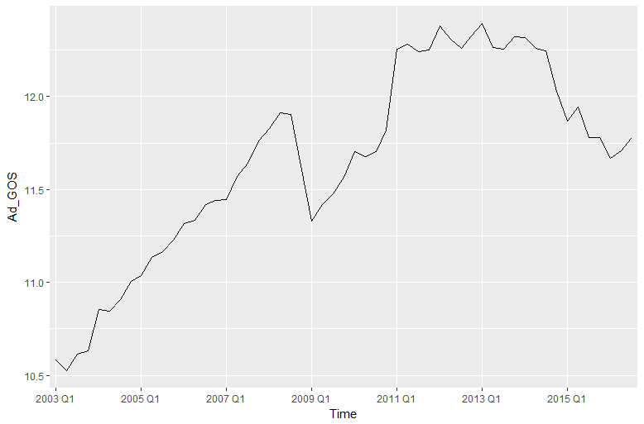
Log Transformation on GDP and GOS

Slide 8
Unit root tests
Augmented Dickey-Fuller test: All series are I(1)
 | GDP | Diff_GDP | GOS | Diff_GOS | REE | Diff_REE | GBC | Diff_GBC
None | -1.832 | -4.726*** | -1.618 | -4.445*** | -1.565 | -5.959*** | -2.116 | -5.490***
Constant | 1.886 | 7.494*** | 1.445 | 6.627*** | 1.680 | 11.990*** | 1.889 | 10.07***
Con. + Trend | 2.729 | 11.240*** | 2.038 | 9.940*** | 2.512 | 17.980*** | 2.825 | 15.098***
Notes:
If a non-stationary series, yt must be differenced d times before it becomes stationary, then it is said to be integrated of order d. We write yt ∼ I(d).

Slide 9


?

Slide 10

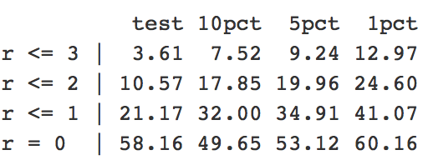
Cointegration-Johansen test
Lag Selection: Varselect( )
Johansen Test: find one cointegration relationship

Slide 11
Vector Error Correction Model
Vector Error Correction Model
Only have one cointegration relationship, then,
where

Slide 12
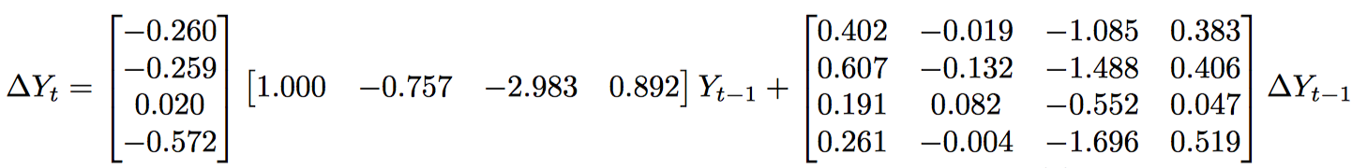
Vector Error Correction Model
Then
Test residuals,
 | GDP | GOS | REE | GBC
ADF Test | -4.7003*** | -4.2066*** | -4.1282*** | -5.2647***
Normality Test | 0.1631*** | 0.6431*** | 0.0041 | 0.0002
Ljung-Box Test | 0.8729 | 0.9267 | 0.5577 | 0.971

Slide 13



Cointegration- Engle and Granger test
Test if there is Unit root in each component series individually by using ADF.
Test cointegration among the components, i.e., to test whether is I(0).
• If Yt =(Y1t,Y2t,…,Ymt) is cointegrated, is I(0) where =(1, 2,…, m). Then, is also a cointegrated vector where

Slide 14
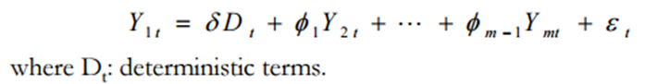


Cointegration- Engle and Granger test
EG consider the regression model for Y1t
Check whether residual term is I(1) or I(1)
If I(1), then Yt is not cointegrated.
If I(0), then Yt is cointegrated with a normalized cointegrating vector
Steps:
Run OLS. Get estimate
Use residual for unit root testing.

Slide 15
Cointegration- Engle and Granger test
Is cointegrated?
 | GDP | GOS | REE | GBC
GDP |  | No | No | No
GOS | No |  | No | No
REE | No | No |  | Yes
GBC | Yes | No | Yes

Slide 16
Causality test of GDP and GBC
Granger Causality Null Hypothesis | P-value
GDP do not Granger-cause GBC | 0.7794***
GBC do not Granger cause GDP | 0.0051
GBC granger causes Russia GDP.
At the same time, Russia GDP does not granger cause GBC

Slide 17

Error Correction Model of GDP and GBC
Select Lags
Then,

Slide 18
The residual of ECM
Test | Value
ADF | -5.0995***
Normality Test | 0.0001
Ljung-Box Test | 0.9994***
By using the ADF test, we can find out that the residual of ECM follow the I(0).
Thus, the long run are stationary.

Slide 19
Comparison of Engle-Granger Test and Johansen Test
Two methods are essentially different, and may disagree on inferences from the same data. The Engle-Granger two-step method for estimating the VEC model, first estimating the cointegrating relation and then estimating the remaining model coefficients, differs from Johansen's approach.
The cointegrating relations estimated by the Engle-Granger approach may not correspond to the cointegrating relations estimated by the Johansen approach, especially in the presence of multiple cointegrating relations. It is important, in this context, to remember that cointegrating relations are not uniquely defined, but depend on the decomposition of the impact matrix.

Slide 20

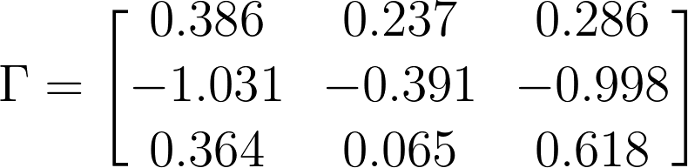
New Vector Error Correction Model
After using Engle-Granger test, we will model GDP, REE and GBC with VECM.
Johansen Test: The impact matrix has rank 2.
Model:
where

Slide 21
New Vector Error Correction Model
 | GDP | REE | GBC
ADF Test | -5.366*** | -4.496*** | -5.317***
Normality Test | 0.005 | 0.003 | 0.0002
Ljung-Box Test | 0.7132*** | 0.9465*** | 0.7491***

Slide 22
Vector Autoregressive Model
VAR model is successful and flexible models for the analysis of multivariate time series.
VAR model is a multi-equation system where all the variables are treated as endogenous.
Especially useful for describing the dynamic behavior of economic and financial time series
Useful for forecasting

Slide 23
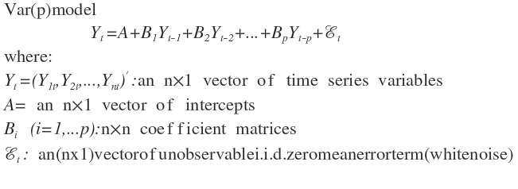
Vector Autoregressive Model
vector of unobservable i.i.d. zero mean error term (vector white noise)

Slide 24
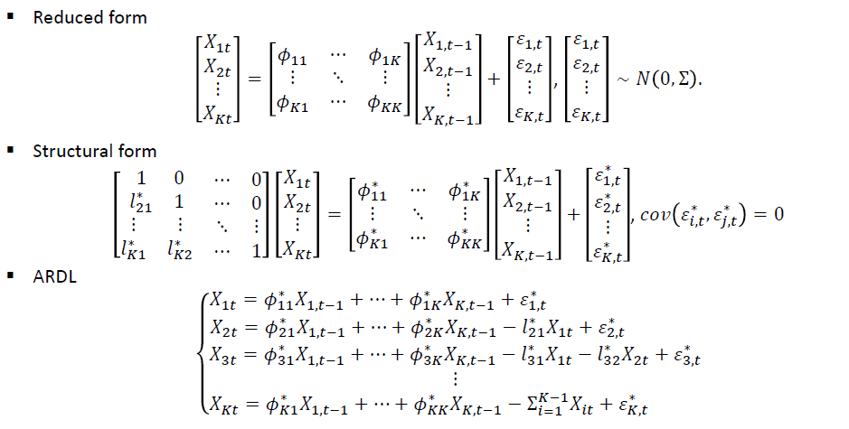
Vector Autoregressive Model
Notes:
Autoregressive distributed lag model

Slide 25

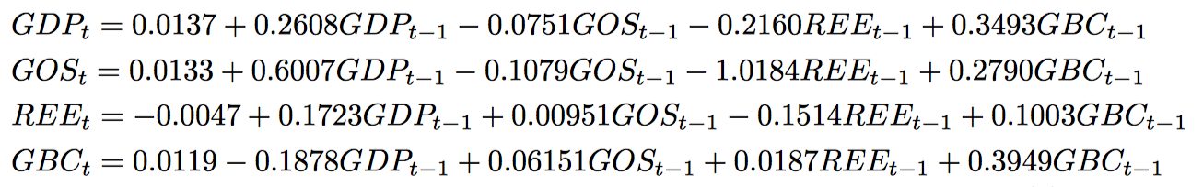
Vector Autoregressive After Difference
Select lag
VAR with lag 1
Notes:
SC is simply another name for the BIC (SC stands for Schwarz Criterion after Gideon Schwarz who proposed it). HQ is the Hannan-Quinn criterion and FPE is the “Final Prediction Error” criterion.³ Care should be taken using the AIC as it tends to choose large numbers of lags. Instead, for VAR models, we prefer to use the BIC.

Slide 26
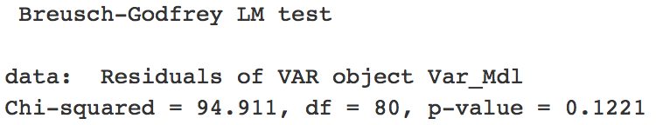
Breusch-Godfrey test
H0: There is no ACF of any order up to 10
Fail to reject H0, our residuals of VAR model are independent。

Slide 27
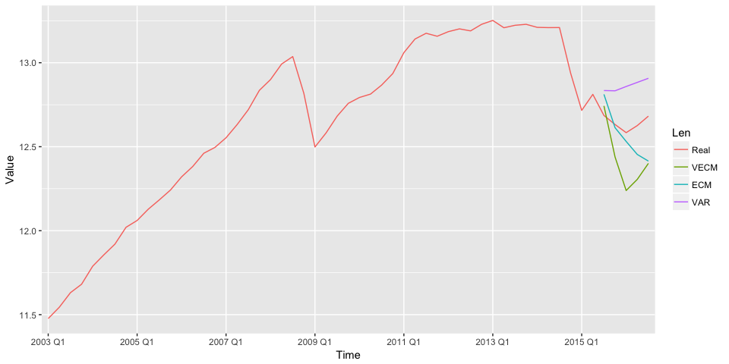
Predict GDP
Notes:
Do the in-sample Prediction from 2015Q2 to 2016Q3

Slide 28
Conclusion
We examined how sensitive Russia’s output and fiscal policy are to changes in international oil prices and the real exchange rate of the rouble. The findings support the prevailing common view that both of these factors play a major role in the Russian economy.
More interesting, we found Russia’s GDP and international oil prices has a long-run stationary relationship.

